Slide 1

Analysis of an Inverted pendulum using optimal control techniques.
MAE 506 Advanced System Modelling & Control
Aravind Adith Pandian Saravanakumaran
Monish Dev Sudhakhar
December 2, 2021

Slide 2
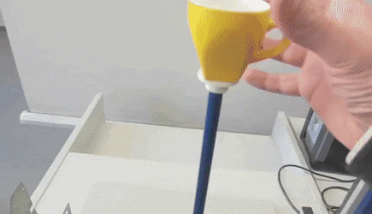

What is an Inverted Pendulum
A pendulum that has its Centre of Mass above the pivot point.
Highly Non-Linear
Applications:
Humanoid Robots
Segway
Rockets
Ball Robots

Slide 3
Objective
To analyse if the system is controllable.
To analyse the effect of changing poles on the inverted pendulum.
To find the best possible location of the pole to have a better control action.
To control the angle of the pendulum using the different proportional gains.

Slide 4
Approach to Problem
Study of System Dynamics
EOM of Inverted Pendulum
Mathematical Modeling
Linearizing the Non-Linear Dynamics
MATLAB
Set up State space model
Design Controller
Pole placement , LQR , PID…
Results
Observe the plots

Slide 5
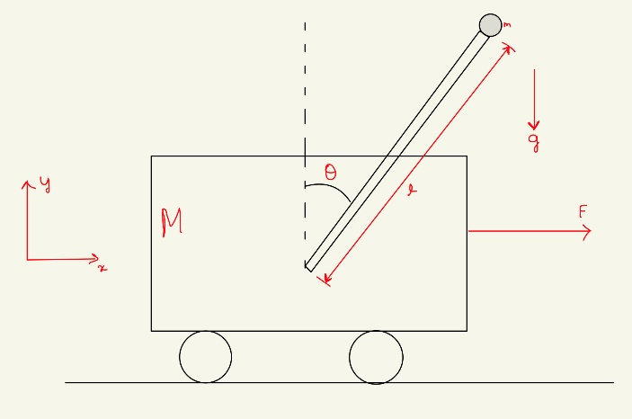
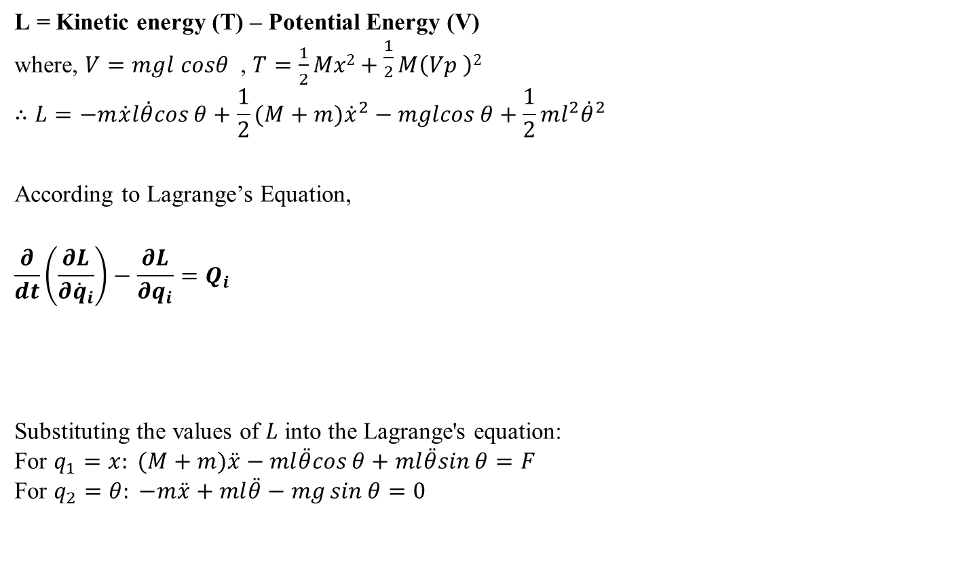
Mathematics – Nonlinear System Dynamics
L = Kinetic energy (T) – Potential Energy (V)
where, $V=mgl cosθ$, $T=\frac{1}{2}Mx2+\frac{1}{2}M\left(Vp \right)2$
$$∴L=−m\overset{˙}{x}l\overset{˙}{θ}cos⁡θ+\frac{1}{2}(M+m){\overset{˙}{x}}^{2}−mglcos⁡θ+\frac{1}{2}ml^{2}{\overset{˙}{θ}}^{2}$$
According to Lagrange’s Equation,
$$\frac{∂}{dt}\left(\frac{∂L}{∂{\overset{˙}{q}}_{i}}\right)−\frac{∂L}{∂q_{i}}=Q_{i}$$
Substituting the values of $L$ into the Lagrange's equation: For $q_{1}=x: (M+m)\overset{¨}{x}−ml\overset{¨}{θ}cos⁡θ+ml\overset{¨}{θ}sin⁡θ=F$ For $q_{2}=θ: −m\overset{¨}{x}+ml\overset{¨}{θ}−mg\sin{θ}=0$
Notations
m | Mass of Pendulum (kg)
M | Mass of Cart (kg)
L | Length of Pendulum (m)
g | Acceleration due to gravity (m/s²)
d | Damping Ratio
s | Position of Pendulum

Slide 6
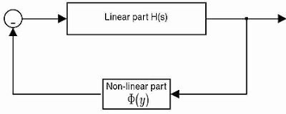
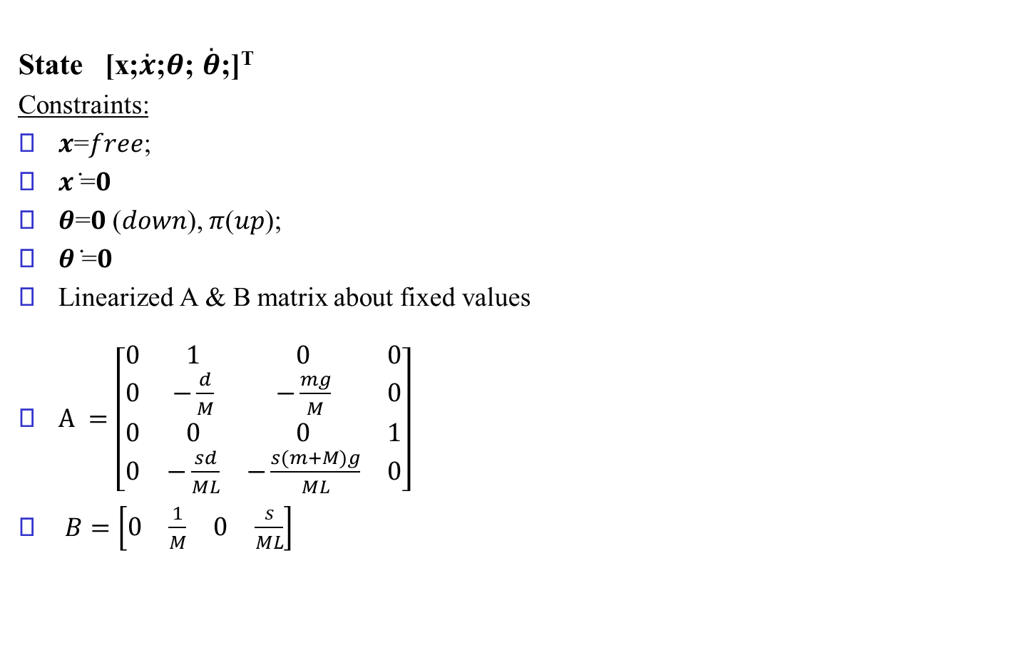
Mathematics – Linear system Dyanamics
State [x;$\overset{˙}{x}$;$θ$; $\overset{˙}{θ}$;]^{T}
Constraints:
𝒙=𝑓𝑟𝑒𝑒;
𝒙 ̇=𝟎
𝜽=𝟎 (𝑑𝑜𝑤𝑛), 𝜋(𝑢𝑝);
𝜽 ̇=𝟎
Linearized A & B matrix about fixed values
$A =\left[\begin{matrix}0 & 1 & 0 & 0 \\ 0 & −\frac{d}{M} & −\frac{mg}{M} & 0 \\ 0 & 0 & 0 & 1 \\ 0 & −\frac{sd}{ML} & −\frac{s(m+M)g}{ML} & 0\end{matrix}\right]$
$B=\left[\begin{matrix}0 & \frac{1}{M} & 0 & \frac{s}{ML}\end{matrix}\right]$
Notations
m = 1 | Mass of Pendulum (kg)
M = 5 | Mass of Cart (kg)
L = 2 | Length of Pendulum (m)
g = -10 | Acceleration due to gravity (m/s²)
d = 1 | Damping Ratio
s = 1 (At top position) | Position of Pendulum

Slide 8
Pole Placement method..
To place the closed-loop poles of a plant in pre-determined locations in the s-plane.
Placing poles is related to the eigen values which control the characteristics of the response of the system.
Controllability has to be checked before placing the poles.
Poles are varied and the response is recorded.

Slide 9
Pole Placement Method - Contd
The system is controllable (full rank matrix)
The State space equation:
𝑥 ̇=𝐴𝑥+𝐵𝑢
𝑦=𝐶𝑥+𝐷𝑢
Control law is 𝑢=−𝐾𝑥 , 𝐴_𝑐𝑙𝑜𝑠𝑒𝑑=(𝐴−𝐵·𝐾)
K = place(A,B,des_eig) #Matlab Command
Proportional gain 𝐾 is found by placing poles at specific locations.
3 Trials in MATLAB were performed by changing the location of poles and checking the time of stabilization.
Initial Condition =[(−3 0 𝜋+0.1 0)] for all cases.

Slide 10
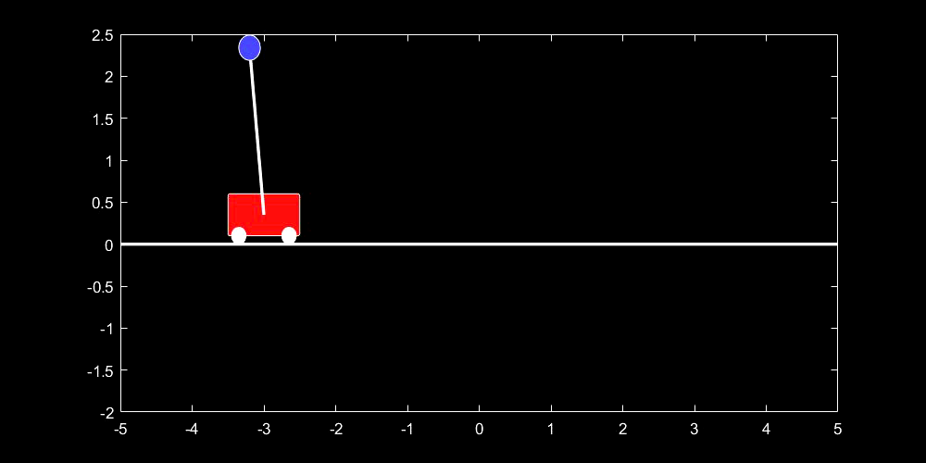
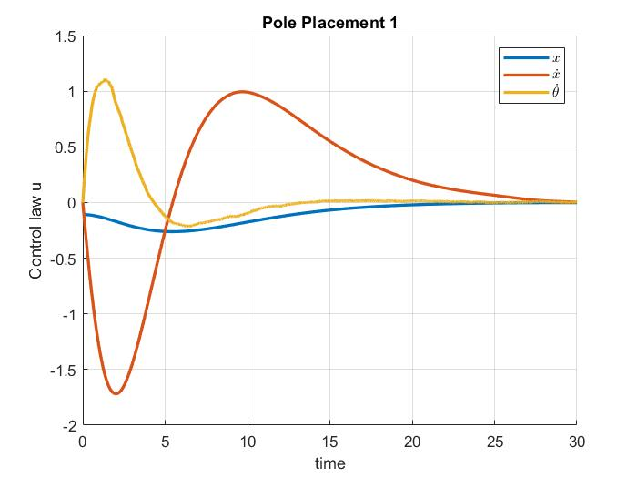
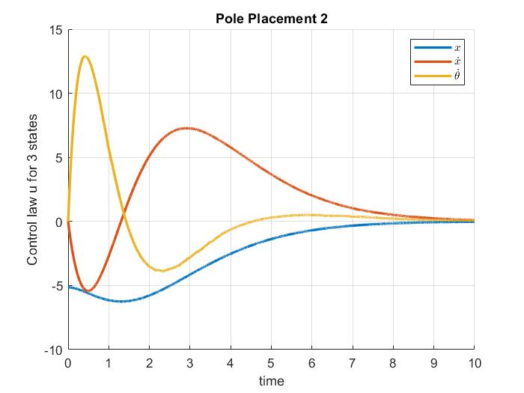
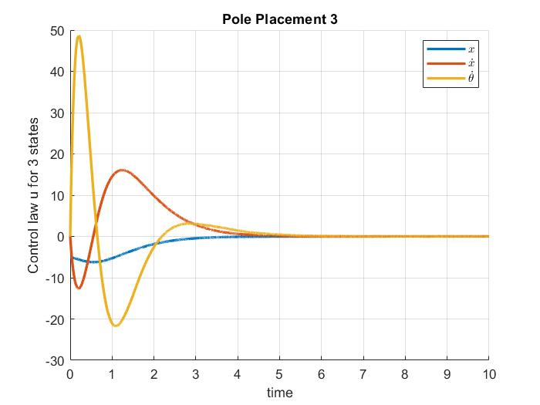
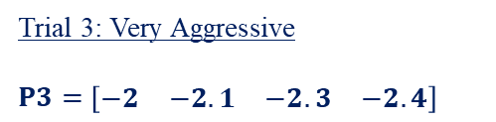
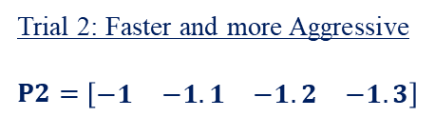
Results – Pole Position Method
Trial 2: Faster and more Aggressive
$P2=$ $\left[\begin{matrix}−1 & −1.1 & −1.2 & −1.3\end{matrix}\right]$
Trial 3: Very Aggressive
$P3=$ $\left[\begin{matrix}−2 & −2.1 & −2.3 & −2.4\end{matrix}\right]$
Trial 1: Slow Response
P1= [−𝟎.𝟑 −𝟎.𝟒 −𝟎.𝟓 −𝟎.𝟔]
When we keep on reducing the desired eigen values, the system becomes more robust the linearity breaks down

Slide 11
Linear Quadratic Regulator
Uses a mathematical algorithm that minimizes a cost function with weighting factors supplied by a human (engineer).
The LQR algorithm reduces the amount of work done by the control systems engineer to optimize the controller.
However, the engineer still needs to specify the cost function parameters depending the weightage for the state variable and cost for driving the input
An iterative process in which the engineer judges the "optimal" controllers produced through simulation and then adjusts the parameters to produce a controller more consistent with design goals.
Difficulty in finding the appropriate weighting factors limits the application of the LQR based controller synthesis.

Slide 12
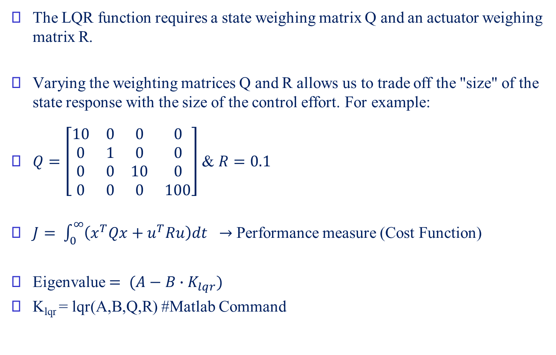
Linear Quadratic Regulator (Contd.)
The LQR function requires a state weighing matrix Q and an actuator weighing matrix R.
Varying the weighting matrices Q and R allows us to trade off the "size" of the state response with the size of the control effort. For example:
$Q=\left[\begin{matrix}10 & 0 & 0 & 0 \\ 0 & 1 & 0 & 0 \\ 0 & 0 & 10 & 0 \\ 0 & 0 & 0 & 100\end{matrix}\right]$ & $R=0.1$
$J= \int_{0}^{∞}{\left(x^{T}Qx+u^{T}Ru\right)dt } →$ Performance measure (Cost Function)
Eigenvalue $= (A−B∙K_{lqr})$
K_{lqr} = lqr(A,B,Q,R) #Matlab Command

Slide 13
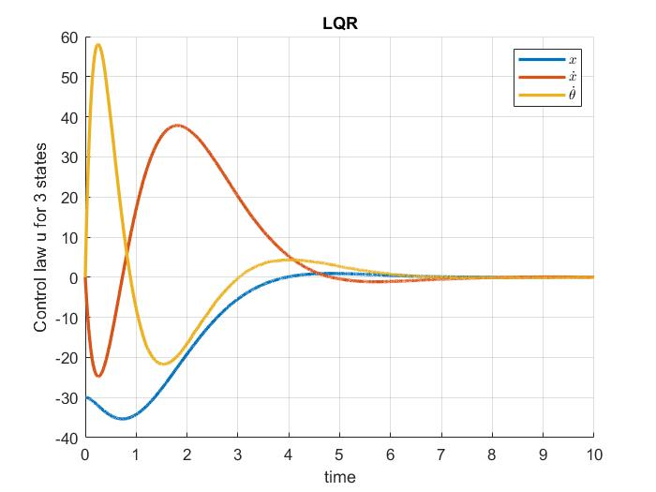
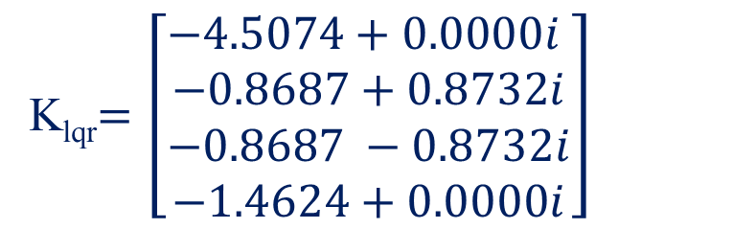
Results - Linear Quadratic Regulator
K_{lqr}$=\left[\begin{aligned}−4.5074+0.0000i \\ −0.8687+0.8732i \\ −0.8687 −0.8732i \\ −1.4624+0.0000i\end{aligned}\right]$

Slide 14
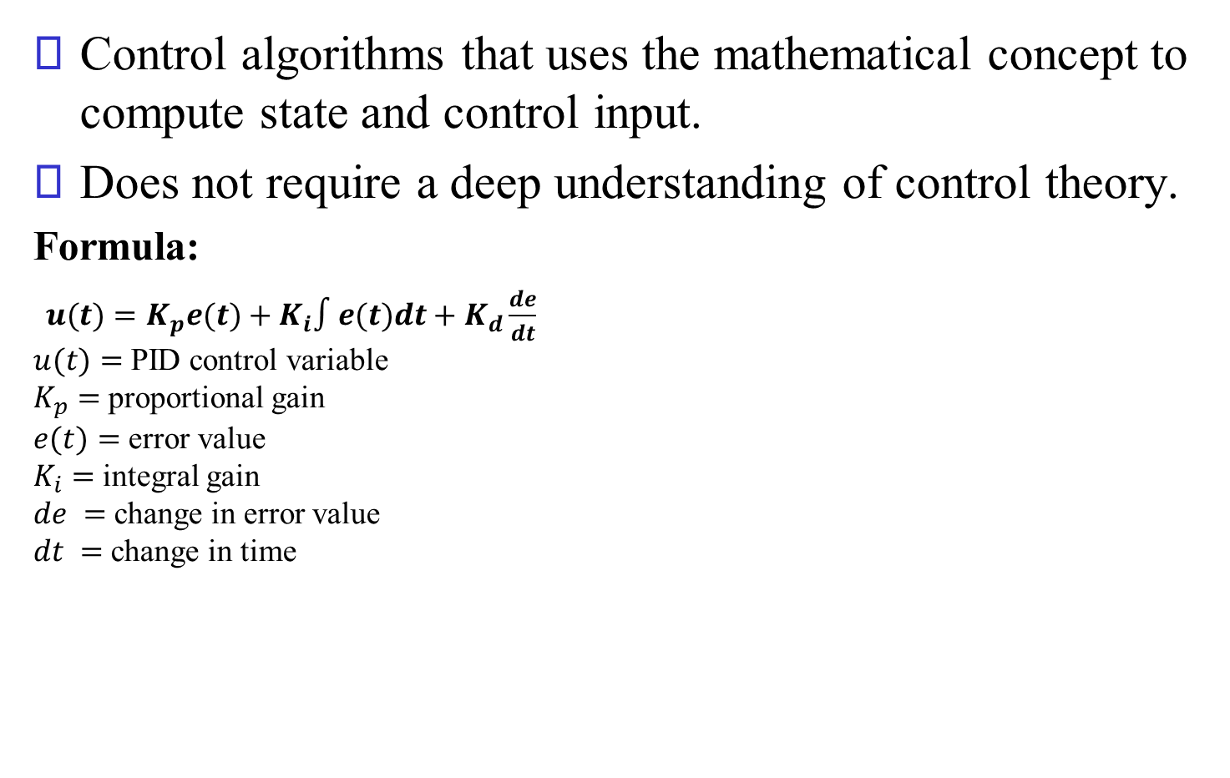
Proportional Integrated Derivative (PID)
Control algorithms that uses the mathematical concept to compute state and control input.
Does not require a deep understanding of control theory.
Formula:
$u(t)=K_{p}e(t)+K_{i}∫e(t)dt+K_{d}\frac{de}{dt}$ $u(t)=$ PID control variable $K_{p}=$ proportional gain $e(t)=$ error value $K_{i}=$ integral gain $de =$ change in error value $dt =$ change in time
CL RESPONSE | RISE TIME | OVERSHOOT | SETTLING TIME | S-S ERROR
Kp | Decrease | Increase | Minor Change | Decrease
Ki | Decrease | Increase | Increase | Decrease
Kd | Minor Change | Decrease | Decrease | No change

Slide 15
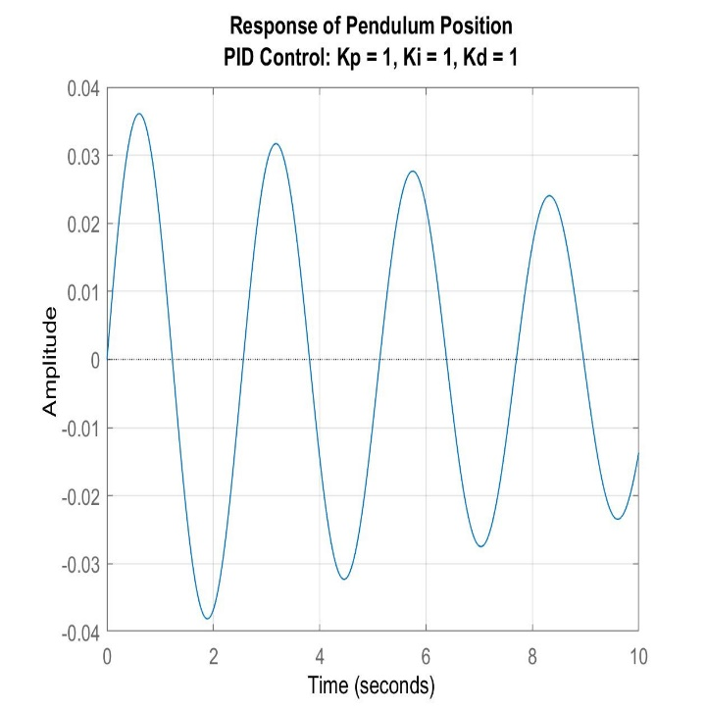
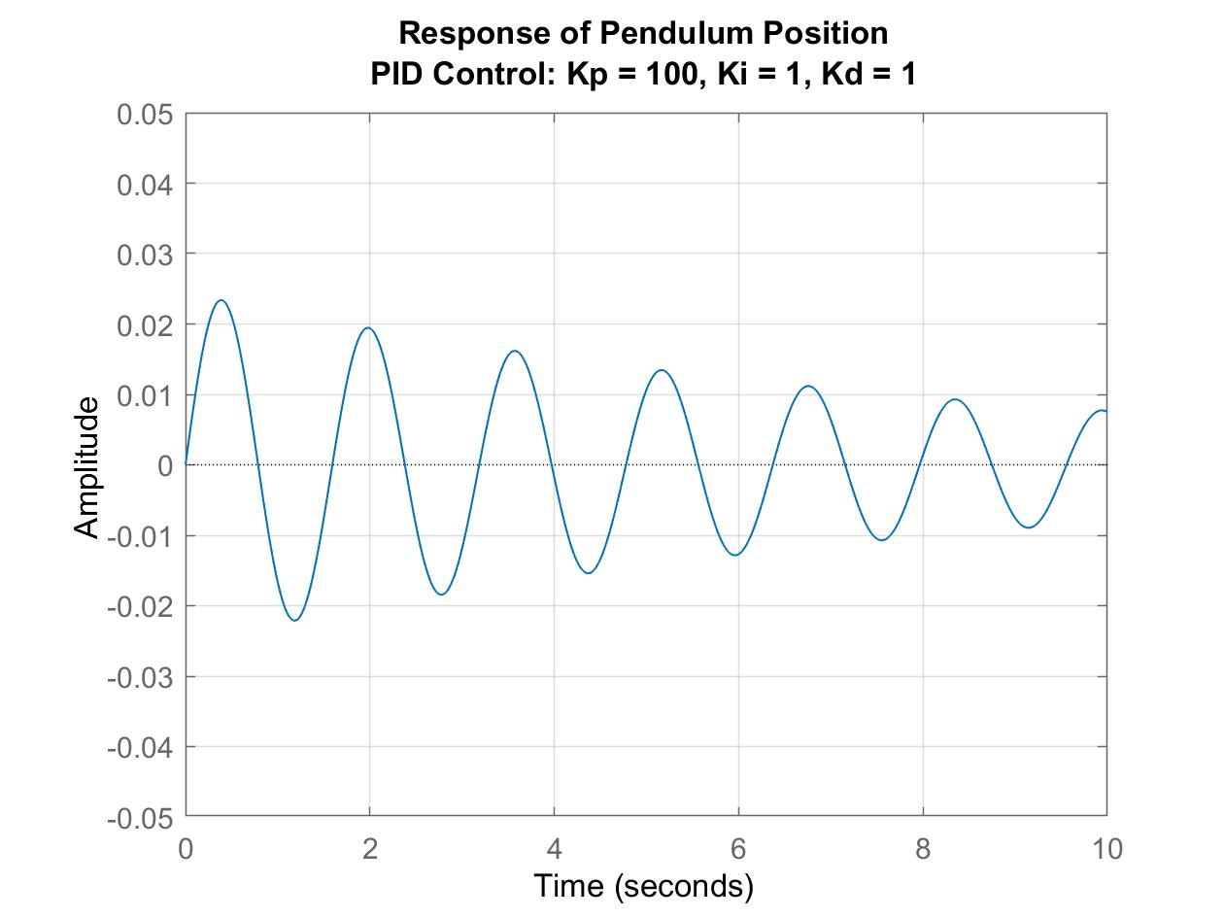
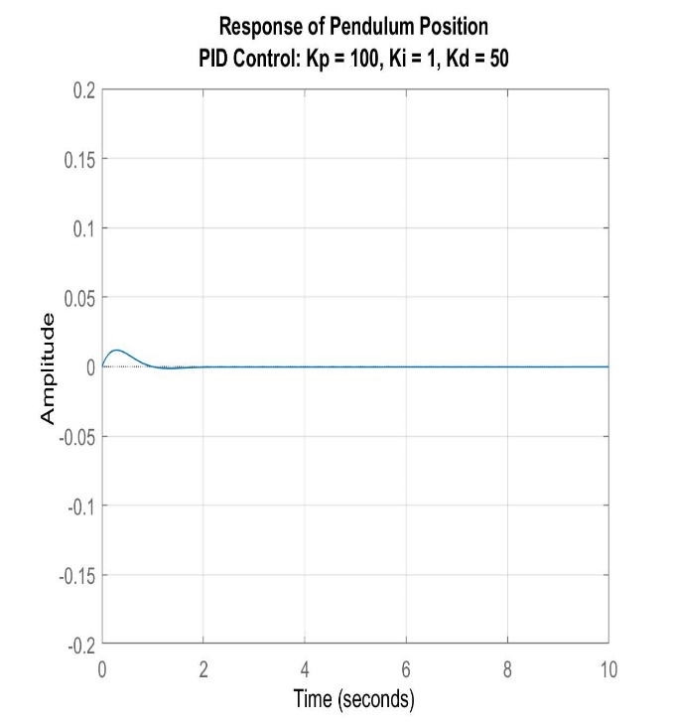
Results - Proportional Integrated Derivative
Overshoot and settling time decreases as we tune the gains.

Slide 16
Observations
The Pole-Position method is the easiest one, but it is not optimal.
The LQR does find the optimal gain matrix which stabilizes the system. But it heavily depends the cost function which is defined by the engineer (Human Factor)
The PID is the most efficient and provides the optimal stability among these methods as it guarantees stability margin by tuning proportional gains.

Slide 17
Questions?

